Slide 1

Loan Approval Prediction
CSCI441 – Machine Learning
Supervised By:
Mr. Maher Abdul Rahman

Slide 2
Our Team
Clarita
Antoun
Georges
Moussa
62230250
92230521

Slide 3
Table Of Content
01
02
04
05
03
Research Problem
Dataset
Exploratory Analysis
06
Pre-Processing
ML Algorithms
Conclusion

Slide 4

01
Research Problem

Slide 5

Introduction
The process of loan approval is a critical aspect of financial institutions, as it directly impacts the institution's profitability and risk management. This project aims to analyze and visualize the patterns and trends in loan approval decisions.

Slide 6

02
Dataset

Slide 7
About the dataset
Size
Feautures
Target
The dataset contains:
45000 rows of data from Kaggle (3.218 KB)
The dataset has 14 columns
The target is one binary label
0 – Rejected
1 - Approved

Slide 8


Features
Age
Loan Intention
Gender
Loan Interest Rate
Education
Percentage of Income Allocated to The Loan
Income
Credit History Length
Employment Experience
Credit Score
Previous Loans on File
Home Ownership
Loan Amount
Loan Status

Slide 9

03
Exploratory Analysis

Slide 10
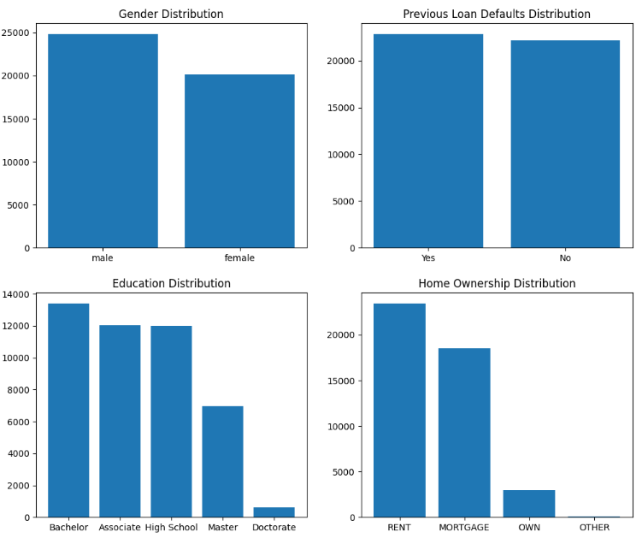
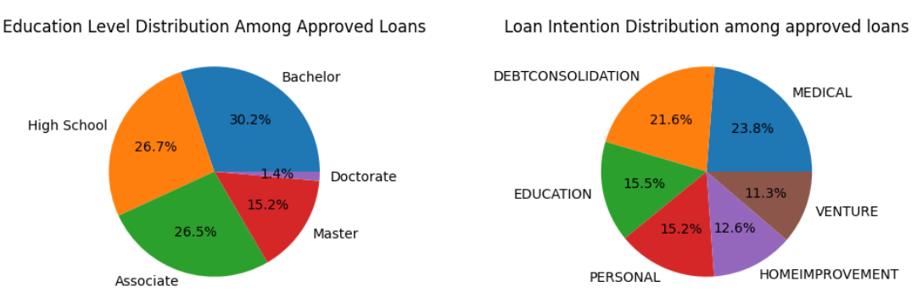
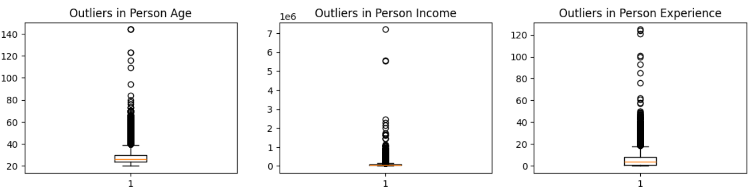
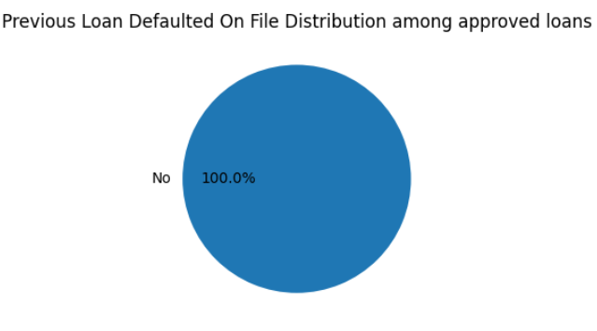


Data Understanding

Slide 11


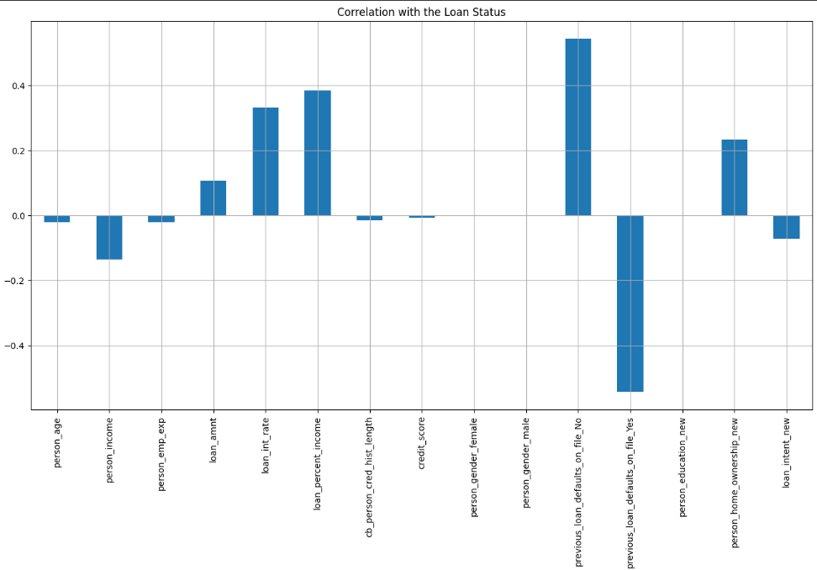
Correlation

Slide 12

04
Pre-Processing

Slide 13

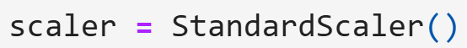




$$σ≈1$$
Standard Deviation

Slide 14

05
ML Algorithms

Slide 15

Type - Classification
Decision Tree
KNearest Neighbors
Random Forest
Naive Bayes
Classifier
Classifier
Classifier
Gaussian

Slide 16
Evaluation Metrics
Precision
Recall
F1 Score
Accuracy
KNearest Neighbors Classifier
0.89
0.90
0.89
0.90
Gaussian Naive Bayes
0.88
0.73
0.75
0.73
Decision Tree Classifier
0.90
0.90
0.90
0.90
Random Forest Classifier
0.92
0.92
0.92
0.92

Slide 17
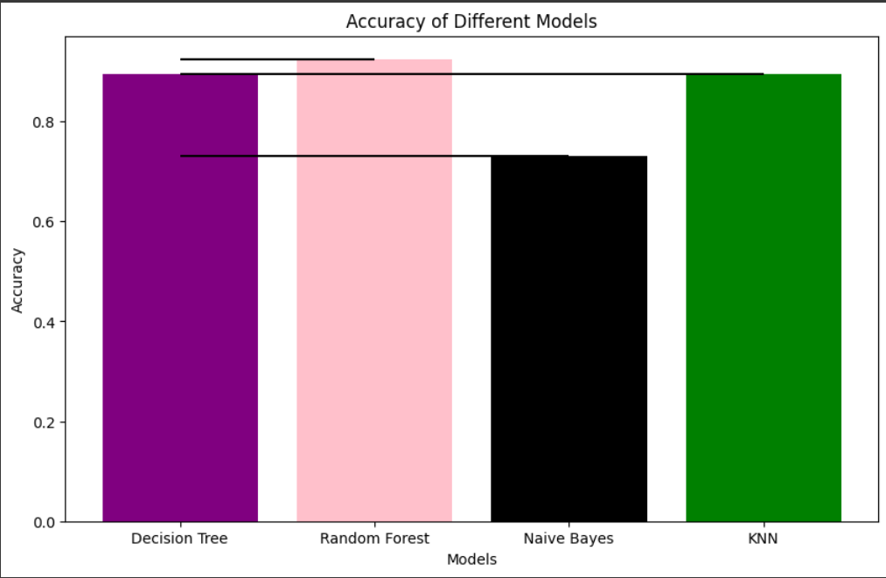
Models Evaluation

Slide 18

Our
Conclusion
06

Slide 19

Conclusion for the applied models
Random Forest
Gives the best Results
Classifier
5
Naive Bayes
Is the least accurate
30%
Gaussian
Having no previous loans on file is cruicial for loan approvals
KNN & Decision Tree
Give almost the same results
Classifiers

Slide 20

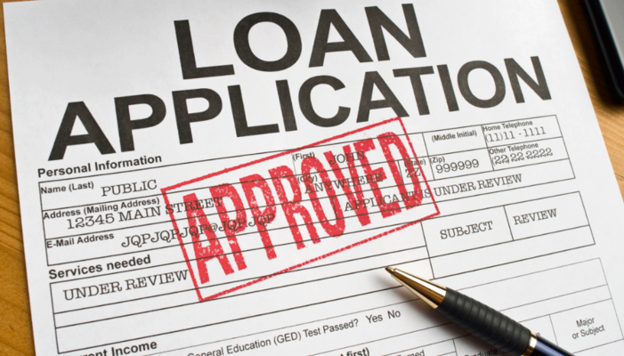
Thanks!
For watching this presentation

